Slide 1
#Workshop: How to design a GUI in the twinkling of an eye
with
26.04.2023

Slide 2
Agenda
#Workshop: How to design a GUI in the twinkling of an eye
Agenda:
Introduction Blume hosts and company ~ 5 min
Introduction of Winstar hosts and company ~ 5 min
Presentation ~ 25 min
Q+A ~ 10 min
Your Blume hosts today:
Wilhelm Haßenpflug
Product Marketing
Eric Kielhorn
Product Marketing
Questions are welcome in the Chat and will be answered in the Q&A part
at the end of the webinar. Everyone will receive a link to a small survey after the webinar. There you can find a download link to the presentation
Notes:
Rules :
Questions in the Chat
In the End we will go through all the questions and answer live or send eMails afterwards
After the Webinar everyone will get an invitation to a small survey

Slide 3
Short Introduction Blume Elektronik
#Workshop: How to design a GUI in the twinkling of an eye

Slide 4
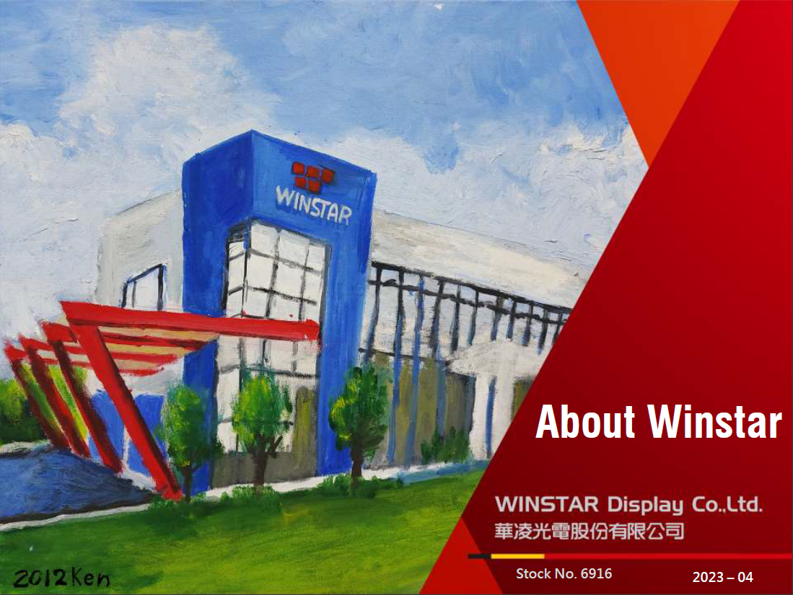

Slide 20
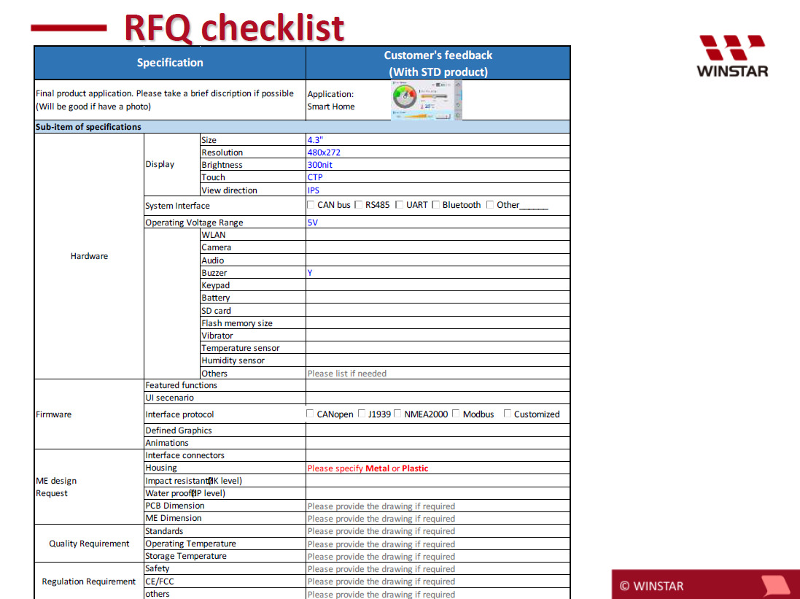

Slide 24
How to stay connected with Blume?
#Workshop: How to design a GUI in the twinkling of an eye
Do you need some help with displays?
You can contact Blume and we‘ll help you!
WILHELM HAßENPFLUG
PRODUCT MARKETING
BLUME ELEKTRONIK DISTRIBUTION GMBH
TECCENTER 1 I 31162 I BAD SALZDETFURTH
FON:(0 50 63) 27 12-0 I FAX:(0 50 63) 27 12-12
EMAIL: HASSENPFLUG@BLUME-ELEKTRONIK.DE
https://www.blume-elektronik.de/

